Slide 1
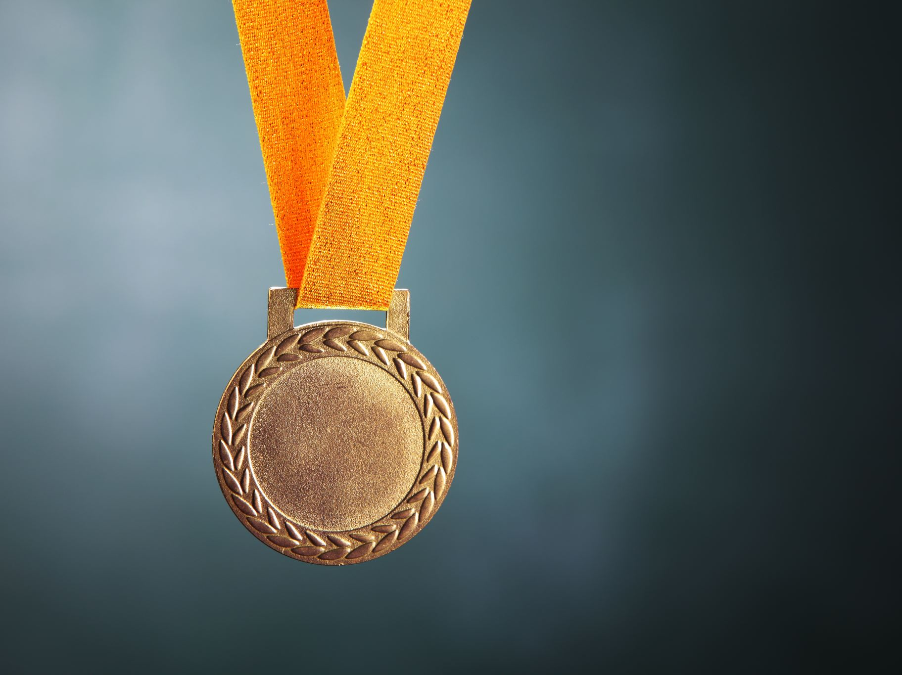
RESPECT

Slide 2
Respect Definition: Showing high regard for self, others, and property.

Slide 3
“The Golden Rule”
Treating others the way you would want to be treated.

Slide 4
Respect Example
Show respect by asking permission before using someone else’s things.

Slide 5
Respect Example Show respect for others even when they are different from you.

Slide 6
Respect Example
Showing respectful behavior is a way of saying, “I care for you”.

Slide 7
Respect Quote
Respect is love in plain clothes.
-Frankie Byrne

Slide 8
Respect Quote When people do not respect us we are sharply offended; yet in his private heart no man much respects himself. -Mark Twain

Slide 9
Respect Quote
When you are content to be simply yourself and don’t compare or compete, everybody will respect you.
-Lao-Tzu

Slide 10
Respect Quotes
Never look down on anybody
unless you’re helping him up.
-Jesse Jackson
Courtesy is the shortest distance
between two people.
-Unknown

Slide 11
Respect Words
Respect
Courtesy
Tolerance
Appreciation
Acceptance
Consideration
Patience
Attentiveness
Manners
Politeness

Slide 12
“The Boy and the Golden Coins” A fable about greed

Slide 13
Once upon a time, there lived a boy who loved money. One day he put his hand into a jar full of golden coins and grasped as many as he could possibly hold. When he tried to pull out his hand, he was prevented from doing so by the small neck of the jar. Unwilling to let go of any coins, yet unable to withdraw his hand, he burst into tears. A woman came along and seeing the boy’s dilemma, she advised, “Be satisfied with half the amount that you’ve grabbed, and you will be able to pull out your hand.”

Slide 14
Discussion Question: 1. What do you think the boy in the fable will do?

Slide 15
Discussion Question: 2. What does it mean to be content with what you have?

Slide 16
Discussion Question: 3. Do you have trouble sharing with others?

Slide 17
Discussion Question: 4. Is it better to have something divided evenly or to get more than your share?

Slide 18
Discussion Question: 5. Who is the most generous person you know? Who is the most content person you know?

Slide 19
Activity Read aloud the fable “The Boy and the Golden Coins.” Have students work in pairs to write two possible endings to complete the fable—one that explains what happens if the boy continues to act selfishly, and one that tells what happens if the boy decides to be unselfish.

